Slide 1

Development of website for a Training Organization
Module Project
Module: Application Development Capstone
Start Date :
End Date :
Submission Date :
Learner Name :
Enrollment ID :
Presentation Date :

Slide 2
Introduction

Slide 3
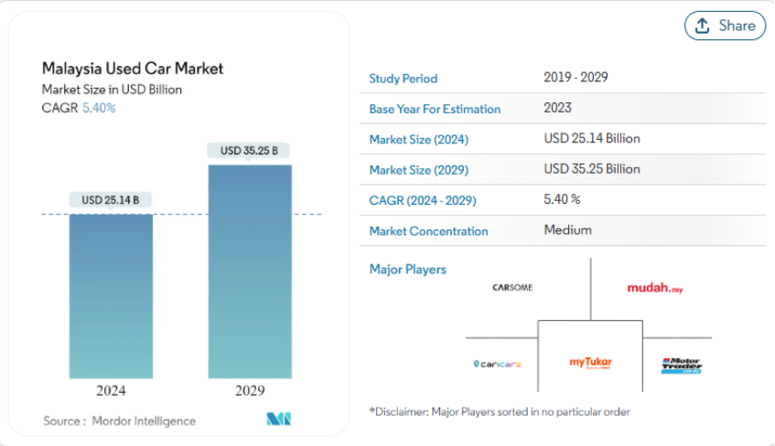
Project Name And Background
Project Name: Library Management System
Background: The used car market in Malaysia has been growing rapidly in recent years.
Market data:
2024: Market valuation at $25.14 billion USD.
2029: Expected to reach $35.25 billion USD, with a compound annual growth rate (CAGR) of 6.92%.

Slide 4
Project Objective And Current Issues
Project Objective: Develop a website for used car auctions.
The goal is to simplify and optimize the buying and selling process of used cars.
Current Issues: Sellers and buyers face several key challenges:
Long waiting times:
Lengthy processes for finding buyers or sellers.
Limited access to potential buyers:
Difficulty reaching a wide audience of serious buyers.
Lack of transparency in transactions:
Unclear processes and concerns over fair pricing.

Slide 5
Project Scope
The project involves developing a used car auction website that supports the following core features:
Account Management:
Users can create, manage, and update their profiles.
Authentication and authorization for secure access to the platform.
Car Auction:
Sellers can list their used cars for auction.
Buyers can browse available listings, place bids, and track auction statuses.
Test Drive Appointment:
Users can schedule test drives for vehicles they are interested in, providing a way to evaluate the cars in person before making a purchase.

Slide 6
Limitations
Virtual Operations Only:
The website will support virtual functions such as vehicle listings, bidding, and appointment scheduling.
Physical activities like test drives and car handovers will be the responsibility of the users and must be arranged independently.

Slide 7
System Architecture and Design

Slide 8
Technical Overview
To ensure the stability, security, and scalability of the system, the project adopts a variety of mainstream technologies. The key technologies used are:
Programming language: Java is used in the backend to ensure system stability and scalability.
Front-end framework: HTML, JavaScript and Bootstrap are used in the front end to achieve dynamic interaction and responsive layout.
Database system: MySQL is selected to ensure data security and efficient access.
Development tools: VSCode is used to provide efficient development environment and plug-in support.

Slide 9




Technical Overview
Programming Language:
Backend: Java
Java is a mature, stable, and highly scalable programming language widely used in enterprise-level application development.
It efficiently handles user requests, data access, and system interactions, making it an ideal choice for building robust backend services.
Frontend Framework:
HTML, JavaScript, and Bootstrap
HTML: Used to structure the content on the webpage.
JavaScript: Handles dynamic interactions and frontend logic to ensure a smooth user experience.
Bootstrap: Provides responsive layouts and modern UI components, which help in quickly building webpages that are adaptable to various devices (desktop, tablet, mobile).

Slide 10

Technical Overview
Database System:
MySQL
MySQL is an open-source, reliable relational database management system that supports efficient data storage and retrieval.
It ensures data integrity and consistency while providing the performance required for high-traffic applications.
Development Tools:
Visual Studio Code
Visual Studio Code is used as the primary development environment due to its rich plugin ecosystem, built-in debugging features, and flexible workspace configurations.
VSCode supports multiple programming languages, making it a versatile and productive environment for both front-end and back-end development.

Slide 11
System Architecture
The system consists of three main components:
Frontend Interface - The user interface that interacts with the users.
Backend Server - Handles business logic, data processing, and interactions with the database.
Database - Stores and manages data, such as user information, car listings, and transactions.
Interaction Flow:
User Interaction: The user interacts with the frontend interface through a web browser.
Backend Processing: The backend processes the business logic, handling tasks such as user authentication, car auctions, and booking test drives.
Database Interaction: The backend communicates with the database to retrieve or store data as needed.
Result Display: The backend then sends the results back to the frontend, which displays the information to the user.

Slide 12
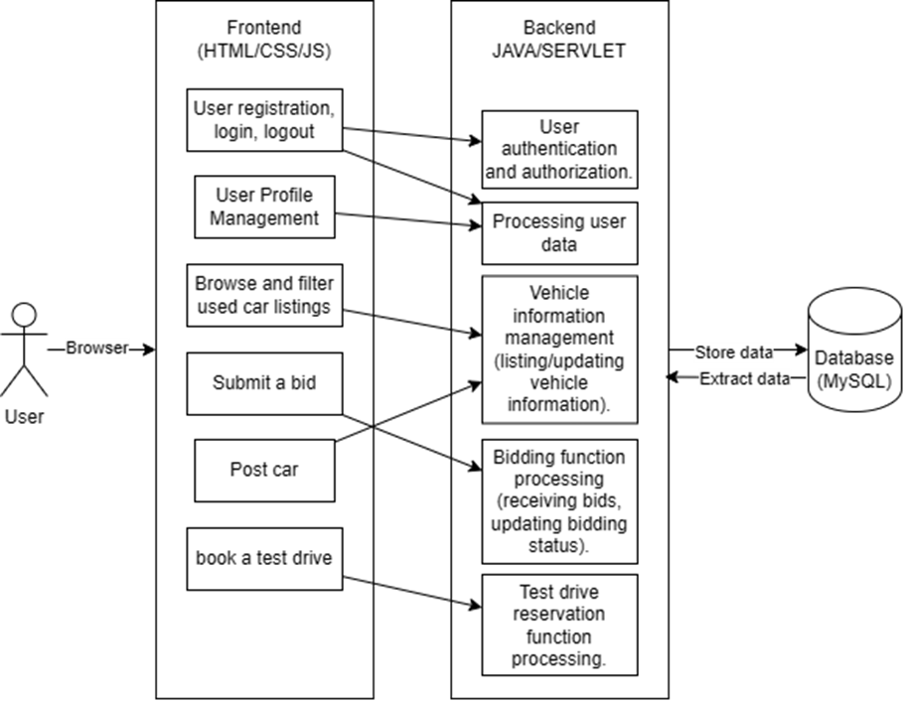
System Architecture Diagram

Slide 13
Database Design
Database Table Structure:
The main tables include:
tb_car (Car Information)
tb_car_bid (Bid Records)
tb_car_picture (Car Pictures)
tb_profile_picture (User Profile Pictures)
tb_role (User Roles)
tb_test_drive (Test Drive Records)
tb_user (User Basic Information)
tb_user_profile (User Profile)
Table Relationships:
The tables are closely linked through foreign keys (e.g., id_user, id_car, id_profile, etc.), enabling the interconnection of information such as cars, users, roles, bids, test drives, and pictures.

Slide 14
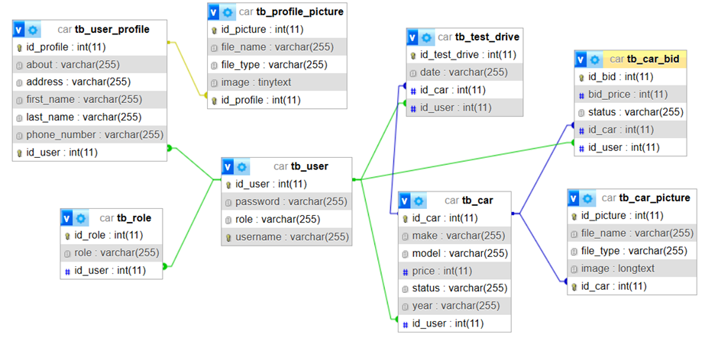
Database Design

Slide 15
Key Code
1. Save User Data:
userRepo.save(saveUser);
This code calls the userRepo.save(saveUser) method, saving the saveUser object (which contains user information, roles, and profile) to the database. This operation involves the tb_user, tb_role, and tb_user_profile tables.
2. Retrieve User Data:
1. Define the query method:
public UserAccount findByUsername(String username);
2. Execute the query:
UserAccount user = userRepo.findByUsername(username);
This allows the system to retrieve user information from the database based on the provided username and returns a UserAccount object.

Slide 16
Demonstration of Key Features

Slide 17
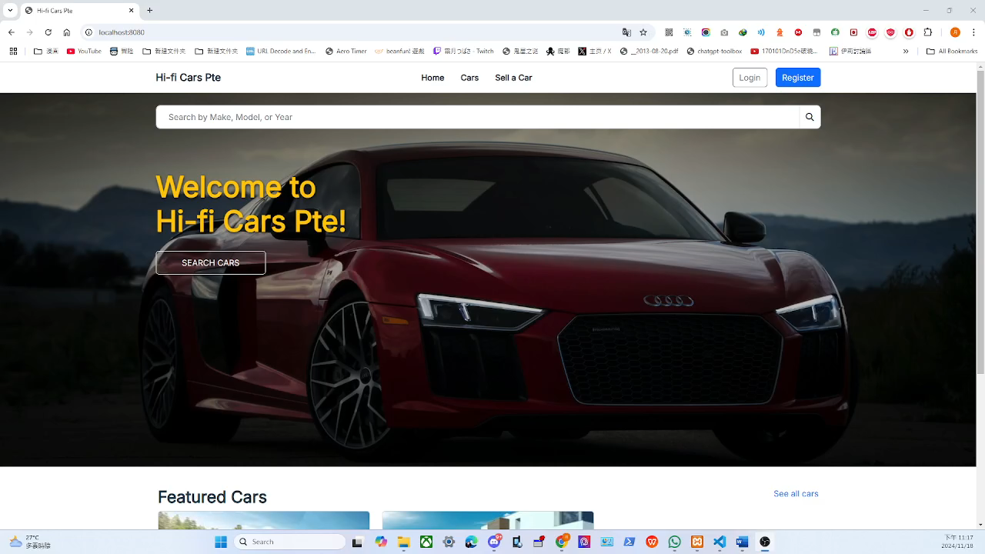
Core Features
User registration and login: Users register with username and password, and password is encrypted and stored to ensure information security when logging in.

Slide 18
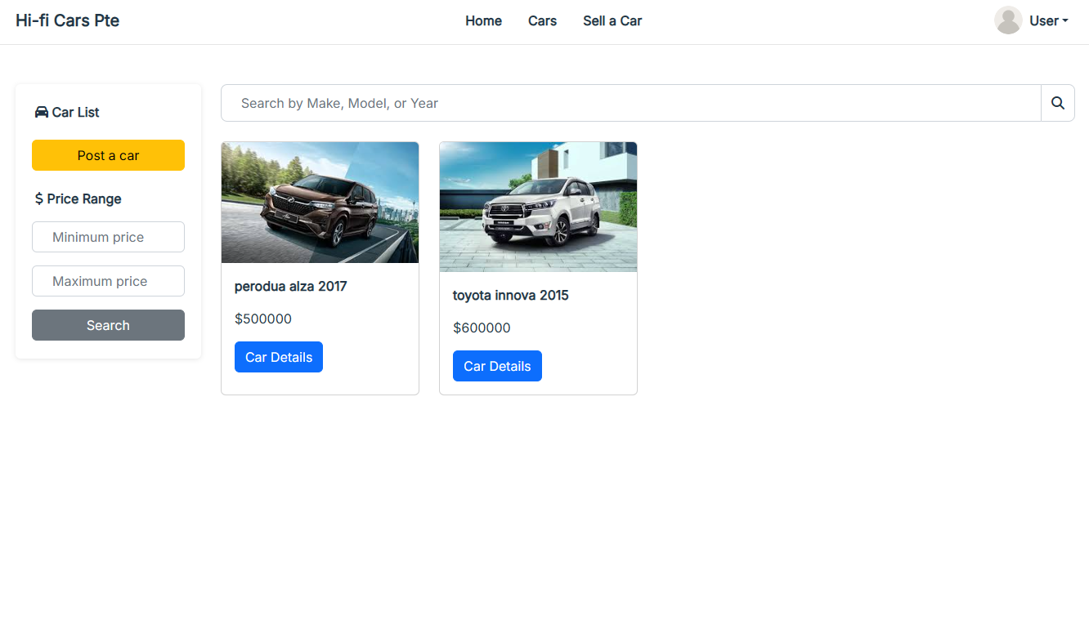
Core Features
Vehicle list function: Sellers can quickly list vehicle information for quick sale.

Slide 19
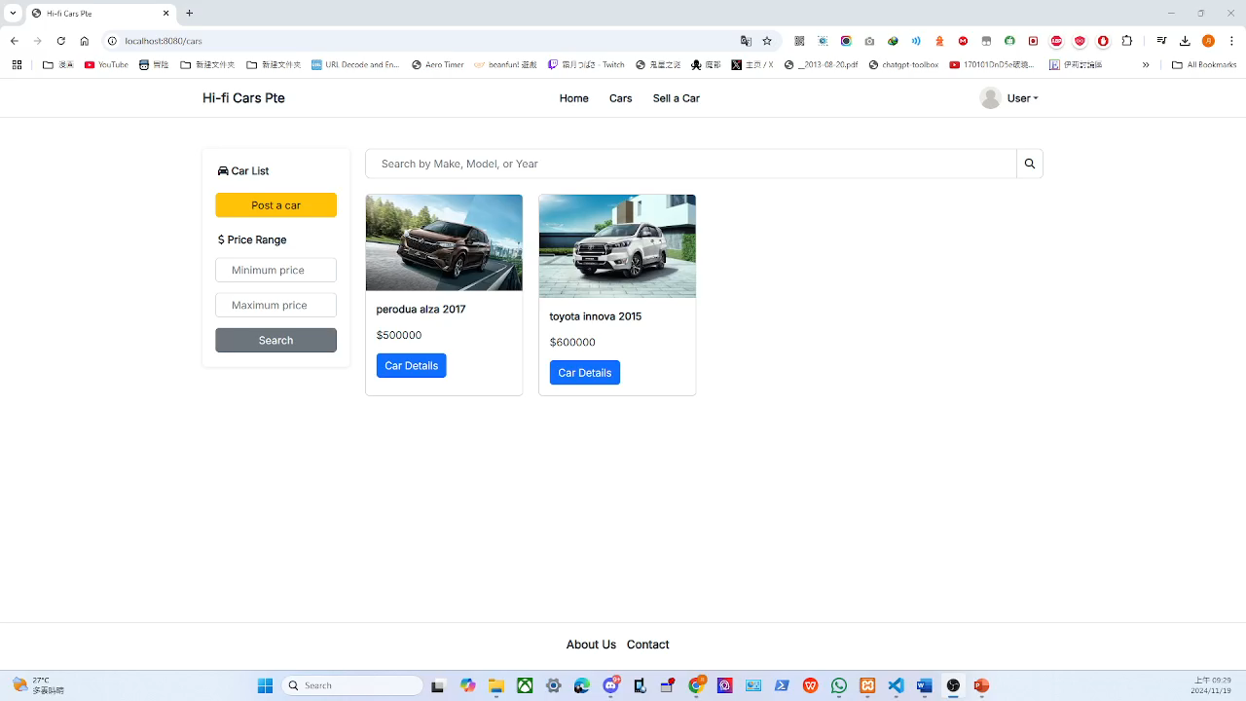
Core Features
Vehicle bidding function: Buyers bid, and sellers decide whether to sell based on the bidding results, promoting transaction transparency.

Slide 20
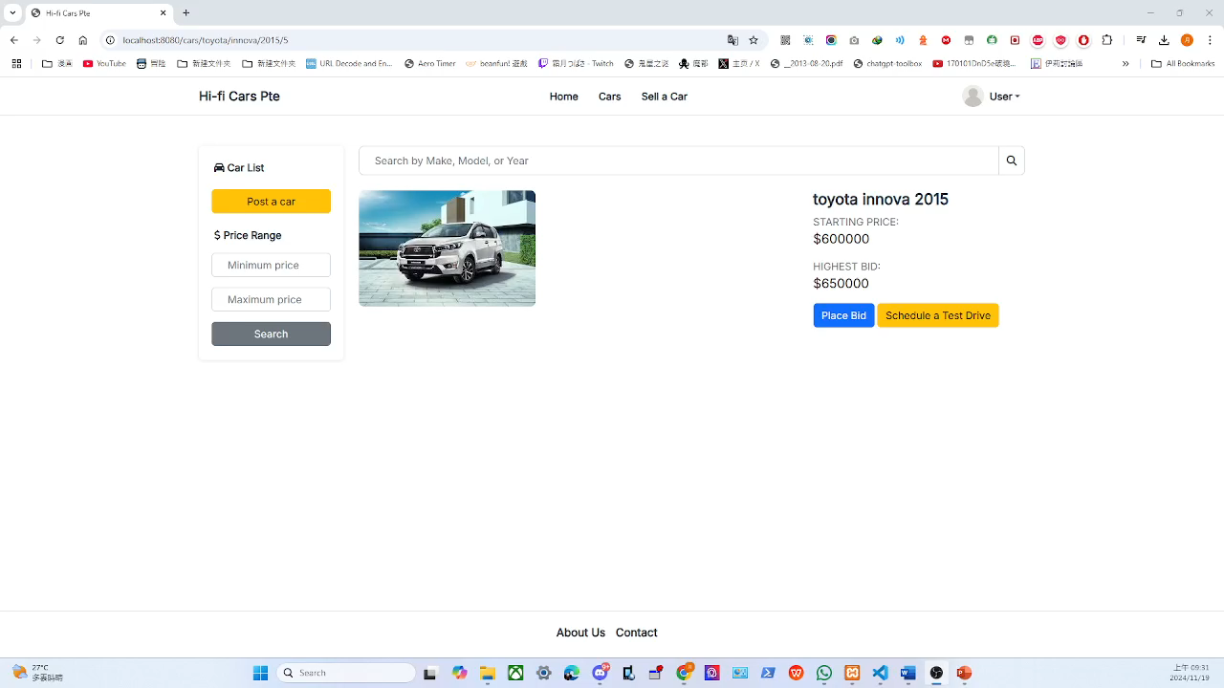
Core Features
Test drive appointment function: Buyers can make an appointment for a test drive to help make a purchase decision.

Slide 21
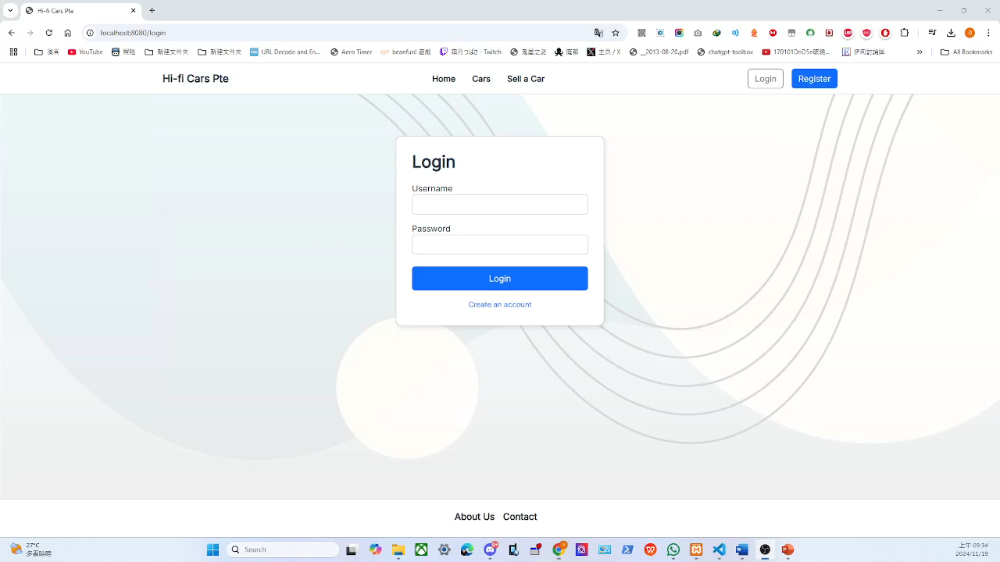
Core Features
User role management: By assigning control permissions through roles, administrators can manage users, vehicles, and bidding to ensure security and data control.

Slide 22
Testing and Quality Assurance

Slide 23
Testing and Quality Assurance
Objective: Ensure that the application functions normally, has stable performance, and is secure and has no vulnerabilities through testing. Testing Strategies: The project adopted the following testing strategies to validate various aspects of the system step by step:
Unit Testing: Independent testing of core application functions to ensure each module works as expected.
Integration Testing: Validation of interactions between different modules to ensure they work together seamlessly.
System Testing: Testing the entire system to ensure functionality completeness and verify system behavior meets requirements.
User Acceptance Testing (UAT): Simulating target user operations to verify the system meets user needs and ensure the application's usability and reliability.

Slide 24
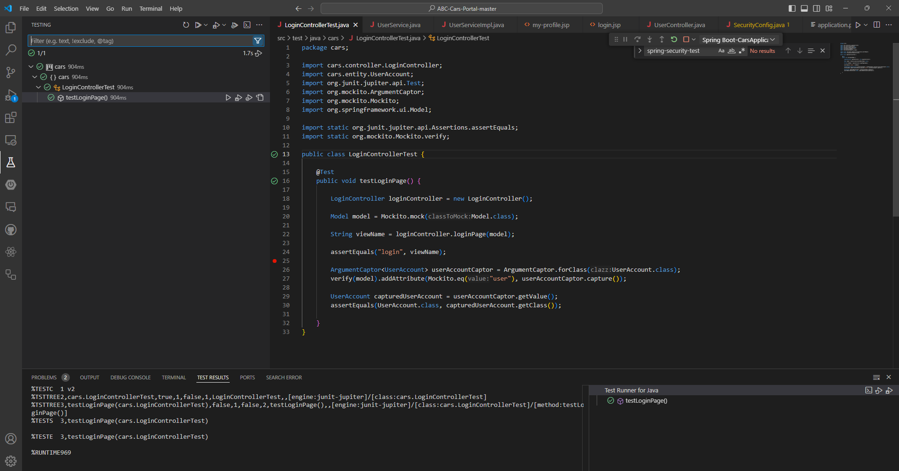
Unit Testing
Validation of Core Functional Modules to Ensure Reliable Functionality
Example Test Case:
LoginControllerTest: Test whether users can successfully access the login page.
Request Success: Returns the expected login page.
Request Failure: Returns an error message or redirects to an error page.
Additional Test Case:
Testing User Registration Functionality:
Valid Input: Registration succeeds.
Invalid Input: Returns an error message.
Test Results: All results align with expectations.

Slide 25
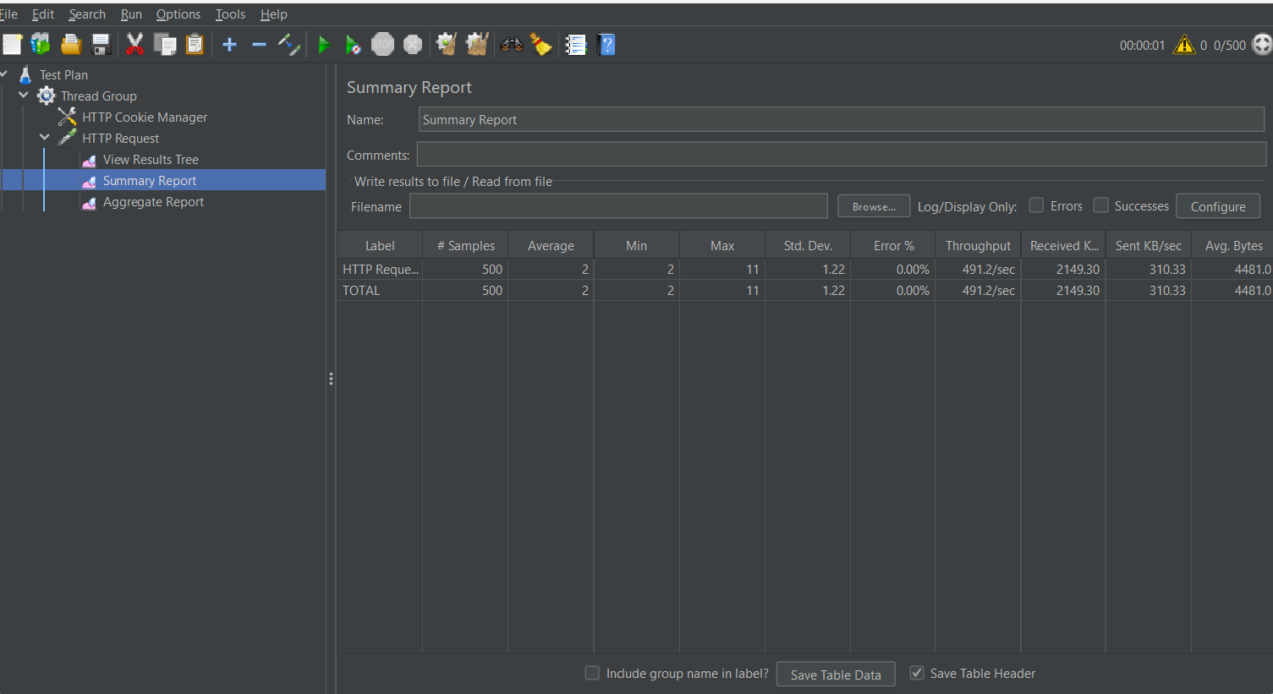
Performance Testing
Testing Tools and Methods
Tool: Apache JMeter to simulate user requests.
Test Scenario:
Simulate 500 users accessing the system simultaneously with a 0.5-second request interval.
The goal is to validate the system’s responsiveness and stability under high load.
Test Results:
No errors occurred during the test (error rate 0%).
The response performance remained strong, with the system able to smoothly handle simultaneous requests from 500 users.
Page load times were significantly optimized, improving the user experience.

Slide 26
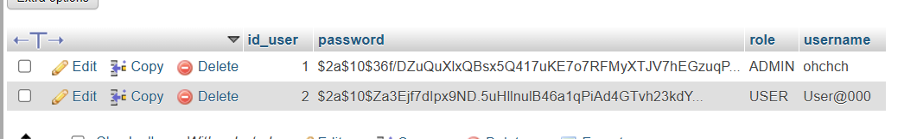
Security Testing
Security Goals:
Ensure encrypted storage of user passwords to prevent plaintext leakage.
Implementation Methods:
Utilize BCrypt encryption algorithm.
Leverage BCryptPasswordEncoder for automatic encryption.
Security Advantages:
Resists brute-force attacks.
Automatically adds salt to prevent rainbow table attacks.
Effectiveness:
Enhances password security and safeguards user privacy from threats.
@Bean
public static PasswordEncoder passwordEncoder() {
return new BCryptPasswordEncoder();
}

Slide 27
Deployment and Optimization

Slide 28
Deployment Process
Hosting Platform: Azure (supports auto-scaling and load balancing).
Key Steps:
Environment Setup: Install required software (e.g., JRE, MySQL, Nginx).
Code Synchronization: Use Git or GitHub Actions to ensure version consistency.
Database Migration: Migrate the development database to the production environment using tools like Flyway.
Configuration File Adjustments: Ensure proper settings for database connections, API keys, etc., in the production environment.
Application Launch: Start the application using Spring Boot, with automatic restart mechanisms configured.

Slide 29
Optimization Techniques
Performance Optimization:
Caching: Use Redis or Ehcache to cache frequently queried data, reducing database load.
SQL Optimization: Avoid complex multi-table joins and add indexes to improve query efficiency.
Frontend Optimization: Compress static resources (Gzip) and leverage CDN for distribution.
Scalability:
Load Balancing: Use Nginx or AWS Elastic Load Balancer for traffic distribution.
Auto-scaling: Dynamically adjust the number of server instances based on traffic changes.
Security Optimization:
HTTPS Encryption: Enable SSL/TLS to secure data transmission.
SQL Injection Prevention: Use parameterized queries and JPA to safeguard against attacks.
Password Encryption: Store user passwords securely with BCrypt encryption.

Slide 30
Optimization Techniques
CI/CD Automation:
Automatically run unit tests, build, and deploy.
Implement rollback mechanisms to quickly recover from failures.
Automate testing to ensure code quality and security.
Continuous Monitoring and Optimization:
Use Prometheus and Grafana for system performance monitoring.
Conduct regular stress testing to ensure stability under high concurrency.

Slide 31
Challenges and Lessons Learned

Slide 32
Challenges
Challenges
Time Management:
Coordinating schedules was challenging due to team members being in different locations and having other work commitments.
Code Transfer Issues:
Inconsistent development environments caused the code to fail when running on different team members' computers.
Solutions
Time Management:
Clear task allocation and enhanced communication.
Implemented regular progress synchronization meetings.
Code Issues:
Systematically checked dependencies and configurations.
Standardized development environments and version control.

Slide 33
Challenges
Lessons Learned
Time Management:
Prioritize communication and planning in the early stages of the project.
Establish milestones and hold regular meetings to ensure alignment.
Technical Collaboration:
Standardizing development environments and tools is crucial for successful teamwork.

Slide 34
Conclusion and Future Work

Slide 35
Project Outcomes Summary
Successfully delivered a second-hand car trading platform with the following key features:
User registration and login.
Vehicle information posting.
Bidding functionality.
Test drive appointment scheduling.
The platform's interactive design enhanced transaction convenience and transparency for buyers and sellers. Its simple and intuitive user interface provided an excellent user experience, earning positive feedback from target users.

Slide 36
Project Outcomes Summary
Successfully delivered a second-hand car trading platform with the following key features:
User registration and login.
Vehicle information posting.
Bidding functionality.
Test drive appointment scheduling.
The platform's interactive design enhanced transaction convenience and transparency for buyers and sellers. Its simple and intuitive user interface provided an excellent user experience, earning positive feedback from target users.

Slide 37
Future Optimization Directions
Payment System: Implement an online payment feature to enable users to complete transactions directly on the platform.
Data Analysis and Reporting: Offer features like sales statistics, bid history, and user behavior analysis to assist platform administrators in making informed decisions.
Social Features: Add a chat function to facilitate direct communication between buyers and sellers, improving transaction efficiency.
Mobile Application Support: Develop a mobile app to allow users to conveniently browse, bid, and schedule appointments on smartphones.

Slide 38
Final Reflections
Importance of Team Collaboration: Despite challenges like remote collaboration and differing work schedules, the team successfully delivered the project on time through effective time management and mutual support. The team demonstrated exceptional problem-solving skills and ensured project progress.
Lessons Learned: This project highlighted the critical role of effective communication and teamwork in project success. Moving forward, there will be a greater focus on improving team collaboration and time management to enhance efficiency and the quality of task completion.

